Slide 1
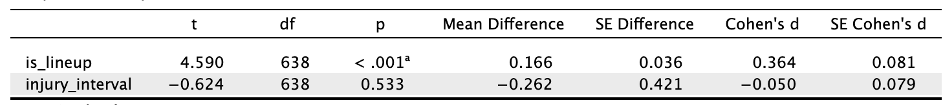
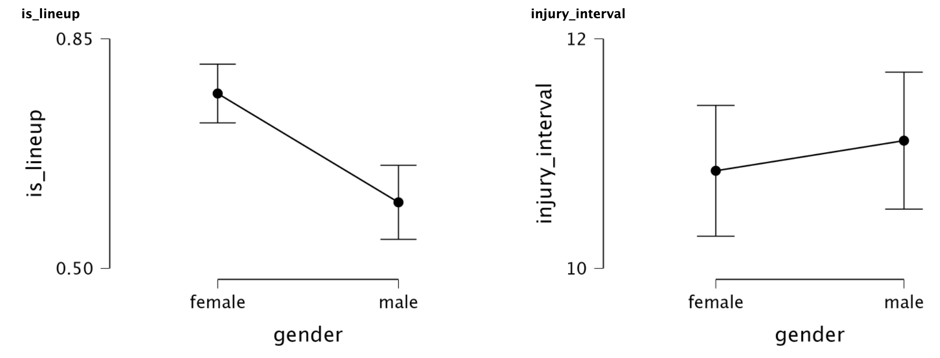
Gender-based injuries in soccer players: Developing machine learning programs to predict the most significant factors.
Alec Zhang
Introduction
Discussion
Soccer is the most popular sport in the world, played by millions of individuals of all ages and genders. While soccer is considered a safe sport, it is still physical, so injuries are inevitable, and the occurrence of injuries can result in severe health consequences for the players. Among the various factors contributing to injuries based on gender, gender itself is a significant one, with male and female soccer players experiencing different types and rates of injuries. In this research paper, I aimed to develop machine learning programs and statistical hypothesis tests to predict the most significant factors contributing to injuries based on gender in soccer players. My study used a large public github dataset by Statsbomb of injury records and player characteristics, which will help evaluate the performance of various machine learning models. The findings from this study could contribute to the development of injury prevention programs that could be implemented into sports-medicine programs at the competitive soccer level tailored to the specific needs of male and female soccer players, ultimately improving the safety and health outcomes of soccer players of all genders.
For my research, I set my null hypothesis as "Gender does not affect injuries," and my alternate hypothesis as "Women's injuries are greater than men's injuries" or "Men's injuries are greater than women's injuries." The alpha cutoff for this study was 0.05. My hypotheses for this study were that in Europe, men would have more injuries than women. With this hypothesis in mind, I also hypothesized that female and male soccer players would be similar in terms of their position, playing time, and starting status. Additionally, I hypothesized that defenders would suffer the most injuries because it is one of the most physically demanding and aggressive positions, and starters would suffer the most injuries because they play for more time. Finally, I hypothesized that more injuries would occur in the second half of the games because more players are tired.
3. I used multivariable regression models in IntelliJ using Python and Jupyter notebook to compare the differences between all of the major causes of injuries. On the x-axis is the time-interval, while the y-axis is the prediction, the position (converting to either goalkeepers, defenders, midfielders, attackers), and lineup, with two lines for the male or females, and the y-axis would be the dependent variable, the number of injuries. I used the following libraries: pandas, seaborn, matplotlib, numpy, sklearn, statsmodels, bioinfokit, and scipy.
Conclusion
Despite only one hypothesis being supported by my evidence in this research, the findings shed light on the effects of time on soccer injuries in both men and women. The positive slopes of the significant graphs indicate that as the game progresses, players become more vulnerable to injuries. The results also highlight the higher injury rates in male midfielders and female defenders, possibly due to the physical demands of their positions. Another observation was that the linear regression lines of female defenders and male defenders, although not significant, had a similar slope to the female midfielders and male midfielders, respectively.
Application
This research can be applied to decrease the number of injuries in a match and make competitive soccer less risky.
Limitations
Some limitations in my research were the lack of different factors to analyze, the lack of an expansive and in-depth dataset, and the lack of enough scale factors to perform an accurate PCA test, as well as perform linear regression and logistic regression with JASP. Another limitation was the presence of outliers, which required manipulation to be removed.
Future Research
This research has important implications for injury prevention in the sports-medicine field and can be further developed and improved using more complex machine learning models and more specific statistics. By analyzing the body parts injured as well as the severity of the injury and working with sports-medicine analysts, the best exercises can be identified to reduce injuries for each position. Future studies can build upon these findings to continue improving safety by implementing new rules to protect players without ruining the competitiveness and physicality of the game.
Results
I found that the difference between the lineup between between females and males are significant rejecting the null hypothesis, while the injury interval accepted the null hypothesis.
Figure 3. The correlation between female starters and the injury rate (R-squared: 0.375, Slope = 0.409, Intercept = 9.807, r = 0.613, p = 0.0053)
Figure 1. Independent t-test with the difference between genders for lineup and injury interval
I found that the difference between the lineup between between females and males are significant rejecting the null hypothesis, while the injury interval accepted the null hypothesis.
Using linear regression, I found that only 4 of 13 of the correlations were significant between the dependent variable and the time interval.
References
Methodology
Zech, A., Hollander, K., Junge, A., Steib, S., Groll, A., Heiner, J., Nowak, F., Pfeiffer, D., & Rahlf, A. L. (2022). Sex differences in injury rates in team-sport athletes: A systematic review and meta-regression analysis. Journal of Sport and Health Science, 11(1), 104–114. https://doi.org/10.1016/j.jshs.2021.04.003
Sprouse, B., Alty, J., Kemp, S. et al. The Football Association Injury and Illness Surveillance Study: The Incidence, Burden and Severity of Injuries and Illness in Men’s and Women’s International Football. Sports Med (2020). https://doi.org/10.1007/s40279-020-01411-8
Post, E. G., Biese, K. M., Schaefer, D. A., Watson, A. M., McGuine, T. A., Brooks, M. A., & Bell, D. R. (2019). Sport-specific associations of specialization and sex with overuse injury in youth athletes. Sports Health: A Multidisciplinary Approach, 12(1), 36–42. https://doi.org/10.1177/1941738119886855
Maggie Mertens, Sept. 17, 2022. “Separating Sports by Sex Doesn’t Make Sense”, The Atlantic https://www.theatlantic.com/culture/archive/2022/09/sports-gender-sex-segregation-coed/671460/,
Chia, L., De Oliveira Silva, D., Whalan, M., McKay, M. J., Sullivan, J., Fuller, C. W., & Pappas, E. (2022). Non-contact anterior cruciate ligament injury epidemiology in team-ball sports: A systematic review with meta-analysis by sex, age, sport, participation level, and exposure type. Sports Medicine, 52(10), 2447–2467. https://doi.org/10.1007/s40279-022-01697-w
Robles-Palazón, F. J., López-Valenciano, A., De Ste Croix, M., Oliver, J. L., García-Gómez, A., Sainz de Baranda, P., & Ayala, F. (2021). Epidemiology of injuries in male and female youth football players: A systematic review and meta-analysis. Journal of Sport and Health Science. https://doi.org/10.1016/j.jshs.2021.10.002
Owoeye, O. B., Aiyegbusi, A. I., Fapojuwo, O. A., Badru, O. A., & Babalola, A. R. (2017). Injuries in male and female semi-professional football (soccer) players in Nigeria: Prospective study of a national tournament. BMC Research Notes, 10(1). https://doi.org/10.1186/s13104-017-2451-x
Using a public github dataset from statsbomb, I parsed through the dataset using Scala and the spark SQL library using Jupyter notebook. I collected the data into a csv file making sure to filter through the country so that the injuries would only include countries in Europe.
In this dataset there are 3 different methods of injuries that I counted as injuries. With all of instances of injuries, I also stored the time interval, position of the player, and status (starter or substitute) of the player.
Comparing values
After accumulating the numbers from the seasons, I examined the data from the male seasons to female seasons, comparing stats like average injuries per match, most frequent injury intervals of injury in each for each gender, and what position suffers the most injuries for each gender.
Used the Student’s T test for Stats comparison, comparing means using Jasp.
H₀ = Gender does not affect injuries (null hypothesis)
H_{a} = Women injuries > Men injuries or Men injuries > Women injuries
Figure 4. The correlation between male midfielders and injury rate (R-squared = 0.228, Slope = 0.214, Intercept = 3.439, R = 0.477, P = 0.0388)
Figure 2. The correlation between ​​total injuries and the injury rate (R-squared = 0.457809, Slope = 0.958, Intercept = 24.053, R = 0.677, p = 0.00147)
Figure 5. The correlation between female defenders and injury rate (R-squared: 0.463543, Slope=0.274, Intercept=2.947, R = 0.681, P = 0.0013)

